Slide 2
Ephemeral Clusters as a Service with ClusterAPI and GitOps

Slide 3



A little about us
Joaquin Rodriguez
Senior Software Engineer
Microsoft
@joaquinrdzv
Alessandro Vozza
Developer Relations
Solo.io
@bongo
Notes:
Who uses ArgoCD
Who uses ClusterAPI

Slide 4
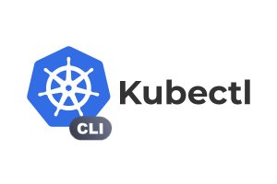



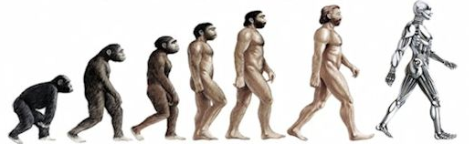

Intro

Slide 5
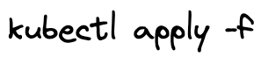


Historical Context
Understanding the Journey to GitOps:
Manual Deployment
Early days of software development
Prone to human errors and inconsistencies
Time-consuming and resource intensive
CI/CD Tools
Introduction of Continuous Integration (CI) and Continuous Deployment (CD)
Automation of build, test, and deployment processes
Improved consistency, speed, and reliability
GitOps
Declarative, Git-centric approach to deployment
Enhanced collaboration, versioning, and rollback capabilities
Easier auditing, traceability, and compliance

Slide 6


GitOps Standards
OpenGitOps: Standardizing GitOps Practices
A CNCF-led initiative for consistent and vendor-neutral GitOps implementation
Principles, Standardization, and Best Practices:
Core GitOps principles as a foundation
Ensures consistency, interoperability, and simplified adoption
Development of guidelines and recommendations for GitOps implementation
Community-driven Approach:
Open discussion and contribution from the community
Evolution based on user experiences and needs
Vendor-neutral Framework:
Flexibility in tool and platform selection
Avoids vendor lock-in for broader adoption

Slide 7
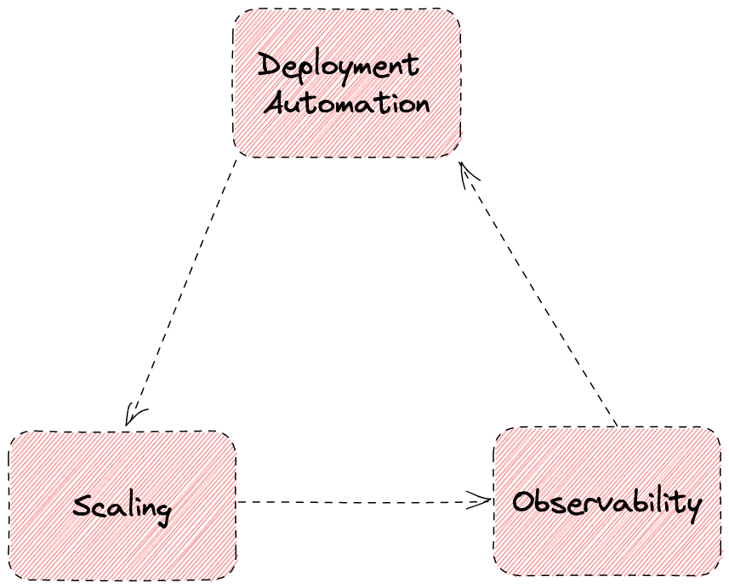
Challenges

Slide 8


Slide 9
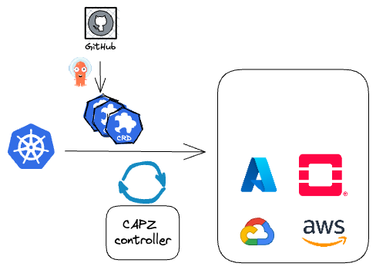

CAPI/CAPZ to the rescue

Slide 10
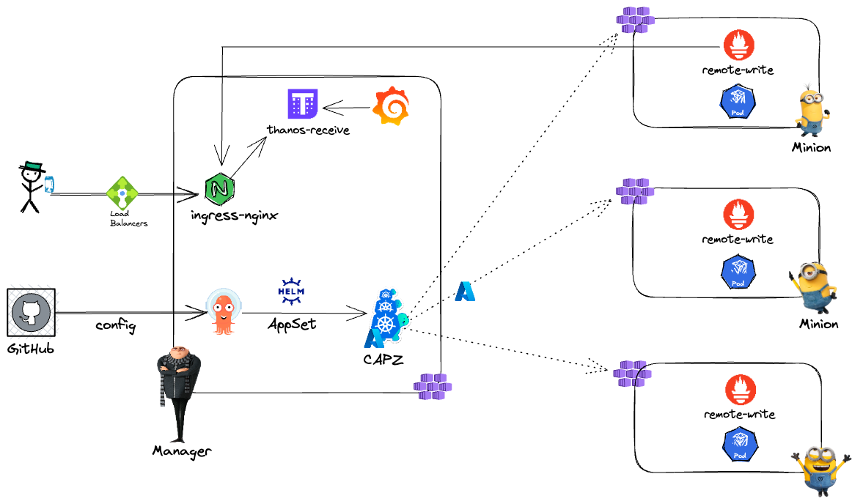
Solution

Slide 11


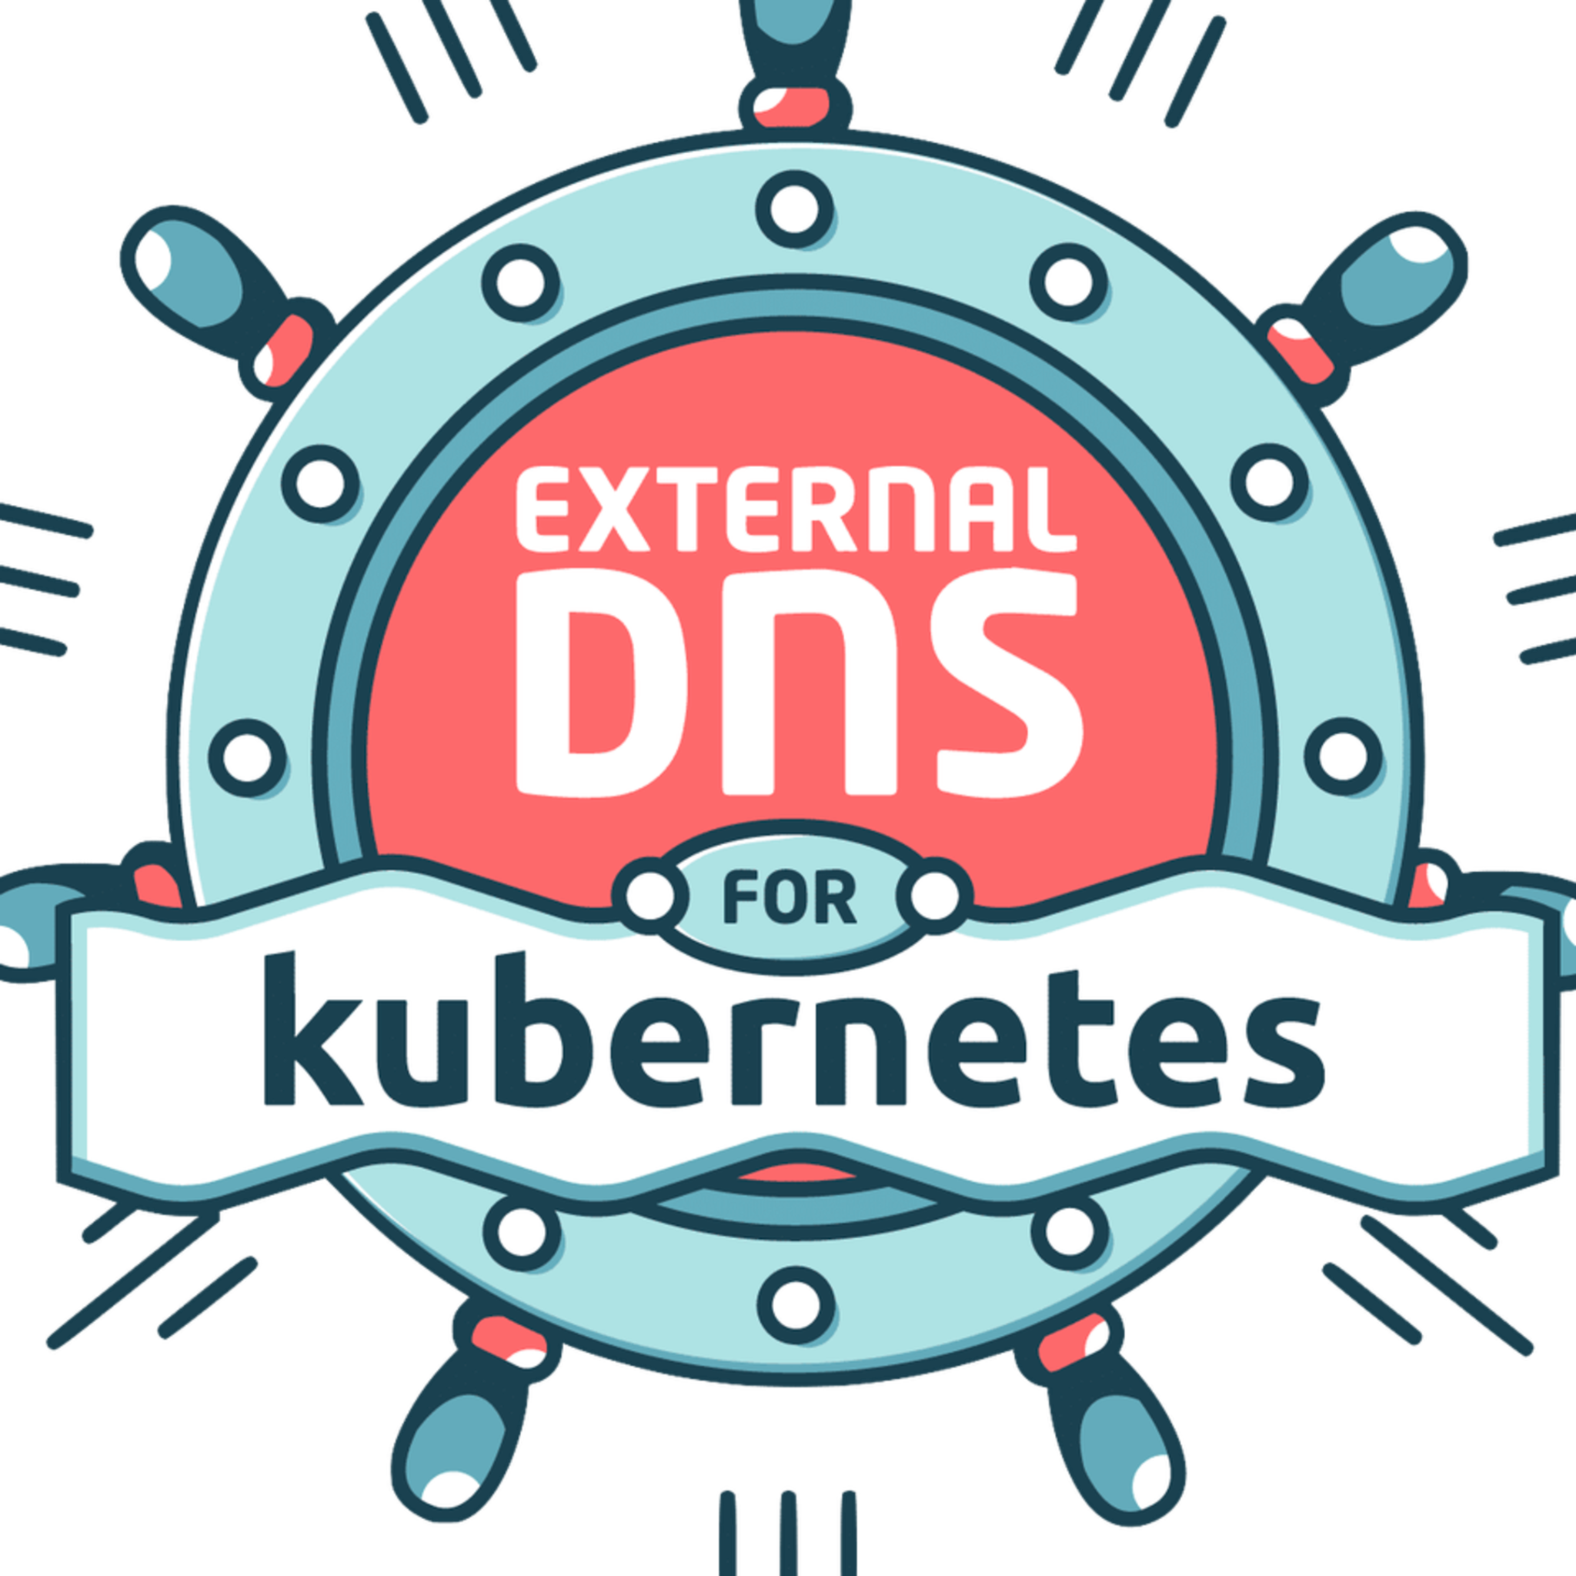







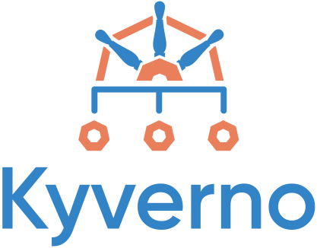

Tech stack
Notes:
ArgoCD the great reconciliator
Shout out to A

Slide 12

Demo

Slide 13
Notable tricks
We use Projects to segregate responsibilities
ArgoCD in read-only mode for demonstration
ServerSide-apply is your friend
Alternative considered: ClusterAPI Helm Add-on
CAPI/CAPZ imperative installation, with capi-operator upcoming

Slide 14
Takeaways
Multiclusters / Multicloud is hard
With the right tools, you can tame the complexity of multicluster
Open source offers the best experience and the best feature set
Split configuration for cluster type

Slide 15
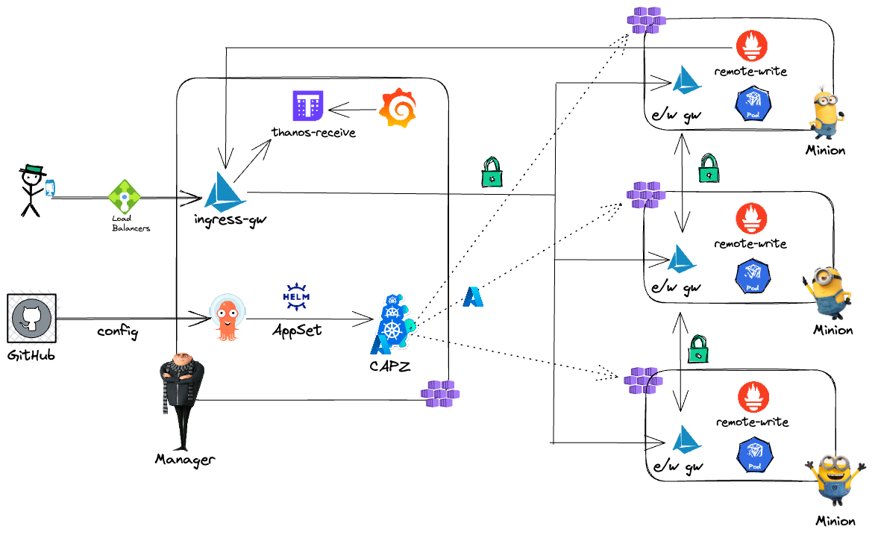
Where do we go from here

Slide 16
Links
github.com/joaquinrz/capi-gitops/
https://github.com/Avni-Sharma/gitopscon_na_2022_session/

Slide 17





See also
Multi-Cluster Observability with Service Mesh - That Is a Lot of Moving Parts!?
Ryota Sawada, UPSIDER, Inc.
Wednesday April 19th - 16:30
Show Me the Metrics: How a Huge Bank Does Observability with Multi-Tenancy Prometheus and Thanos
Rodrigo Serra Inacio & Willian Saavedra Moreira Costa, Itaú
Friday April 21st - 16:00
Keeping It Simple: Cilium Networking for Multicloud Kubernetes
Liz Rice, Isovalent
Friday April 21st - 16:55
Self-Service GitOps at a Regulated Enterprise
Erick Bourgeois, Freelance
Friday April 21st - 16:00
Operate Multi-Tenancy Service Mesh with ArgoCD in Production
Lin Sun, Solo.io & Faseela K, Ericsson Software Technology
Wednesday April 19th - 16:30

Slide 18
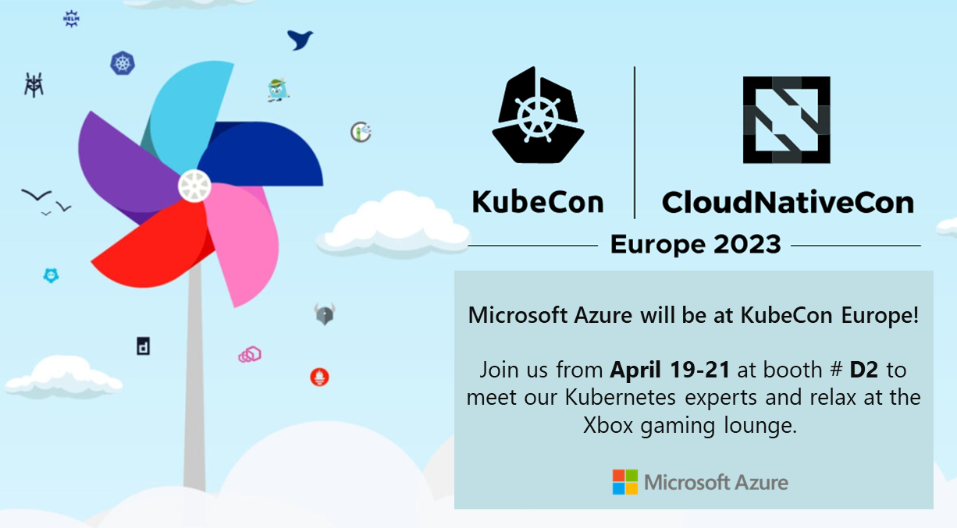

Visit our booths

Slide 19

Please scan the QR Code above
to leave feedback on this session

